Slide 1
Design of Ground Anchors GROUP INTERNSHIP PROJECT Guided by Dr. S. Jayalekshmi
Divya Prabha Velayutham (103117034)
Gollapalli Roopa (103117040)
Sarishma Bhandari (103117086)

Slide 2
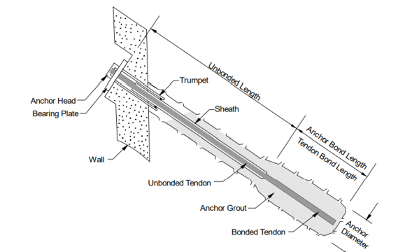
INTRODUCTION
Ground anchors otherwise known as an earth, percussion driven or mechanical anchors, are versatile devices used to hold, restrain and support building, civil engineering and other structures.
Figure 1- Components of Ground Anchors Source: FHWA-IF-99-015

Slide 3
Cont. INTRODUCTION
They come in a wide range of sizes and capacities, up to 70 m in length, with a capacity of more than 3,000 kN.
They are lightweight, corrosion-resistant anchors that can be installed from ground level, either by hand or using portable equipment, depending on size and ground conditions.
When loaded, they exert pressure on a cone of the ground that surrounds their length, providing very good resistance to movement.
As they create minimal soil disturbance during installation and can be stressed to an exact holding capacity, they offer a popular technique for anchoring a wide range of structures into place.

Slide 4
TYPES OF ANCHORS
There are various types of Ground Anchors based on anchorage zone, nature of the structure, installation, application and grouting techniques. All these are briefly explained below.
Based on Anchorage Zone:
Rock Anchors- Bonded Length is anchored in the hard rock.
Soil Anchors- Length is anchored in the Soil.
Based on Design Life:
Permanent Anchors-They have to guarantee their function during the lifetime of the structures to be anchored. They function for more than 24 months.
Temporary Anchors- These are the prestressed anchors which have to fulfill their function only for a limited time. They are quick to install and are cost effective. They function for less than 24 months.

Slide 5
Cont. TYPES OF ANCHORS
Based on the Installation:
Vertical Anchors- These anchors are provided vertically into the ground.
Inclined Anchors- These anchors are provided at an angle into the ground.
Based on Application:
Test Anchors- They are specially designed anchor subjected to extensive tests to obtain information on anchor capacity and geotechnical conditions.
Control Anchors- These anchors are present in or beside the structure used for long-term observation.
Based on Grouting Techniques:
Straight shaft gravity-grouted or Tremie anchors
Straight shaft pressure-grouted anchors
Post-grouted anchors
Under reamed anchors

Slide 6
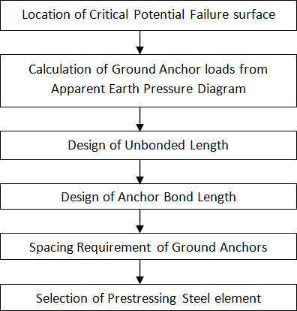
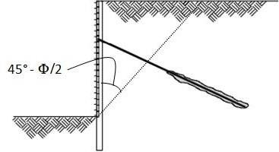
DESIGN OF GROUND ANCHORS
STEP 1: Location of critical failure surface
Figure 3: Location of Critical Failure
Figure 2: Steps for Ground Anchor Design

Slide 7
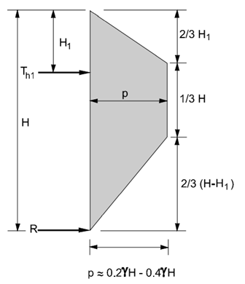
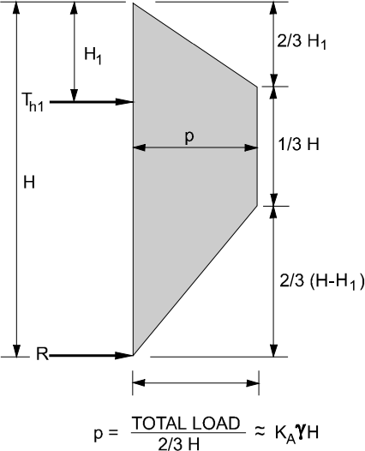
Cont. DESIGN OF GROUND ANCHORS
STEP 2: Calculation of anchor loads
Figure 4: Apparent earth pressure envelop for sand and stiff to hard clays with one level of anchors
Source: FHWA-IF-99-015

Slide 8
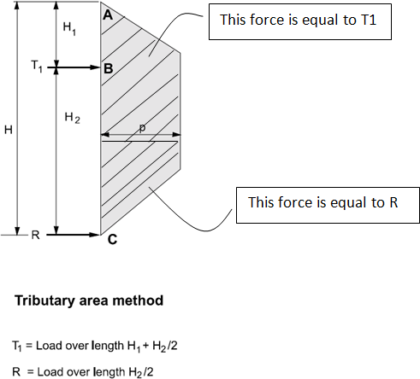
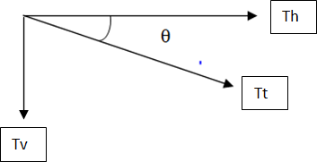

Cont. DESIGN OF GROUND ANCHORS
STEP 2: Calculation of anchor loads
𝑇ℎ = 𝑇1 ∗ 𝑠
Our required anchored load is,
Figure 5: Tributary Area Method for single ground anchors Source: FHWA-IF-99-015

Slide 9

Cont. DESIGN OF GROUND ANCHORS
STEP 3: Design of Unbonded Length
The minimum unbonded length for rock and soil ground anchors is 4.5 m for strand tendons and 3 m for bar tendons.
In general, the unbonded length is extended a minimum distance of H/5 or 1.5 m behind the critical potential failure surface to accommodate minor load transfer to the grout column above the top of the anchor bond zone.
STEP 4: Design of Anchor Bond Length
Here, we use the estimated ultimate transfer load to decide our anchor bond length based on the type of soil and relative density for ground anchors with small diameter. We use the factor of safety 3.

Slide 10
Cont. DESIGN OF GROUND ANCHORS
STEP 5: Space Requirement of Ground Anchors
Typical horizontal spacing for soldier beams is 1.5 m to 3 m for driven soldier beams and up to 3 m for drilled-in soldier beams.
STEP 6: Selection of Prestressing Steel element
The design load shall not exceed 60 percent of the specified minimum tensile strength (SMTS) of the prestressing steel.
Dimensions and strengths of bars and strands commonly used in the U.S. for highway applications are provided in Table of page number 77 of Geotechnical Engineering Circular No. 4 published by U.S Department of Transportation, Federal Highway Administration (FHWA).

Slide 11
PROTECTION OF GROUND ANCHORS
After designing ground anchors, adequate steps for ensuring durability of ground anchor against corrosion are necessary.
The design of corrosion protection systems is performed to protect the steel components of the ground anchor that include the anchor head, bearing plate, trumpet, prestressing steel and couplers.
Components of the corrosion protection system include,
For the anchorage, a cover or concrete embedment, a trumpet, and corrosion inhibiting compounds or grout.
For the unbonded length, grout and a sheath filled with a corrosion inhibiting compound or grout.
For bond length, grout and encapsulations with centralizers or epoxy coatings.

Slide 12
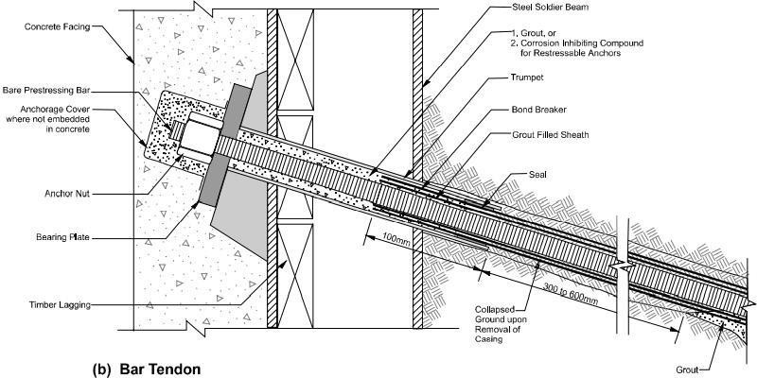
Cont. PROTECTION OF GROUND ANCHORS
Figure 6- Corrosion protection of Bar Tendon Source: FHWA-IF-99-015

Slide 13
GROUND ANCHORS IN INDIA
Though there are not enough guidelines provided for Design of Ground Anchors in IS code, its use has been gaining popularity. Some of the companies that provide anchoring projects in India are;
Keller
KGN Prestress
Sanfield India Ltd.
FPCC Ltd.
FPPC Ltd. used Ground Anchors in Parbati Hydroelectric Project, Himachal Pradesh located in the hilly terrain of Kullu when it faced a serious challenge. During construction of the power house a portion of the slope behind the power house collapsed.

Slide 14
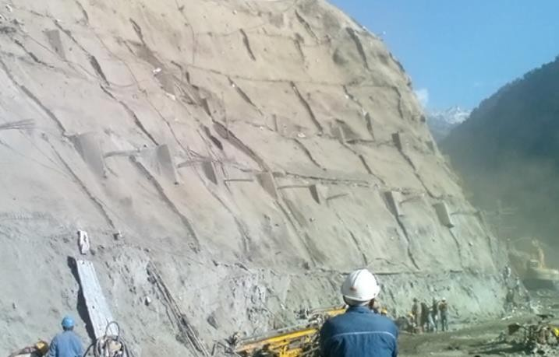
Cont. GROUND ANCHORS IN INDIA
To prevent further landslides and caving, a system of prestressed anchors and rods was devised to stabilize the slopes. Freyssinet 12K13 tendons were used. Shortcreting was done on the slopes after anchoring of the tendons to prevent damage to the slopes due to water. A total area of 90m*175m was stabilized in this manner.
Figure 7- Stabilization of slope for Parbati Hydroelectric Project
Source: https://freyssinet-india.com/projects-post-tensioning-ground-anchors-parbati-hydroelectric

Slide 15
THANK YOU

